Slide 1
UNDERSTANDING POTENTIAL CUSTOMERS FOR TERM DEPOSIT
Direct Marketing Campaign Insights
Through 45216 clients of A Portuguese Bank
By SAGAR CHANDAN

Slide 2
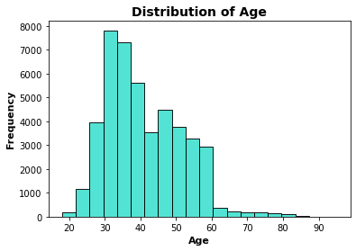
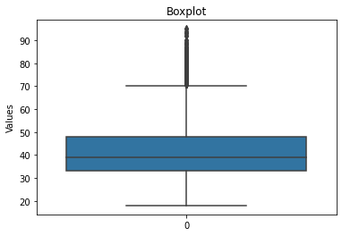
Distribution of Age
The mean age was found to be 40.938 yrs
The median age was 39.0 yrs
The modal age was 32 yrs
The minimum age was 18 yrs
The maximum age was 95 yrs

Slide 3
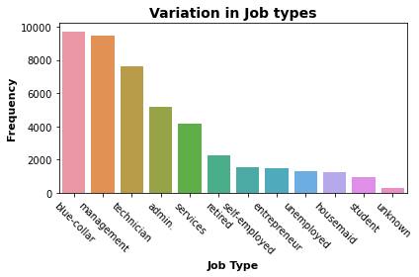
Variation in Job Type
The most common job type was that of Blue-Collar with 9732 entries
Following it were 9460 clients in Management
7597 clients were Technician
5171 clients in Administration
4154 clients in Services
2267 clients were Retired
1579 were Self-Employed
1487 clients were Entrepreneur
1303 Unemployed
1240 were Housemaid
938 were Students
288 client’s job type was unknown

Slide 4
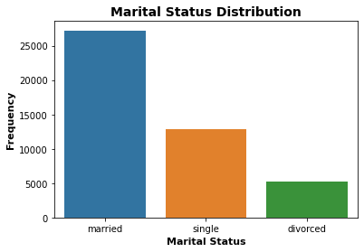
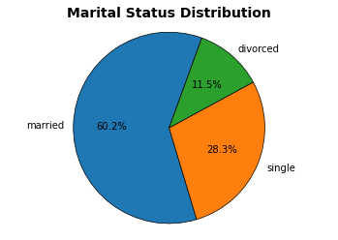
Marital Status Distribution
27219 clients were Married (Around 60.2%)
12790 clients were Single ( Around 28.3%)
5207 clients were Divorced (Around 11.5%)

Slide 5
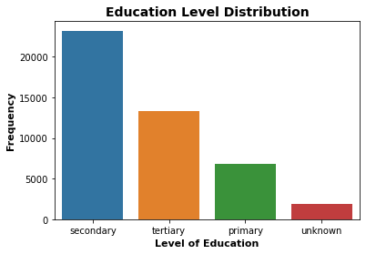
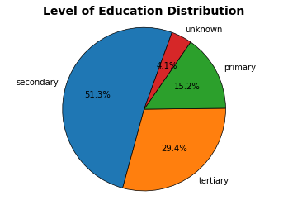
Level of Education
51.3% with Secondary level education (23207)
29.4% with Tertiary level education (13301)
15.2% with Primary level education (6851)
4.1% with Unknown level of education (1857)

Slide 6
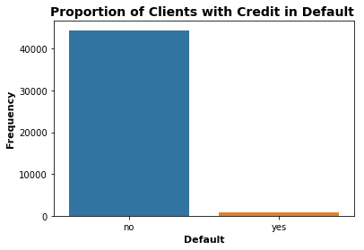
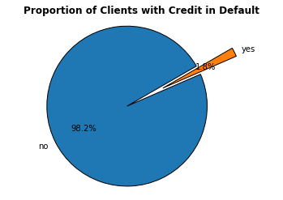
Clients with Credit in Default
1.8% clients(815) had credit in default
The rest 44401 clients had no default (98.2%)

Slide 7
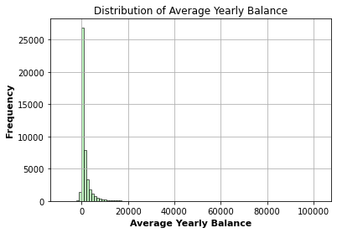
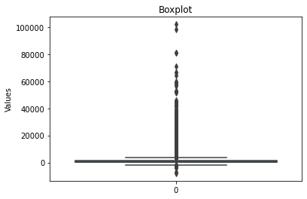
Average Yearly Balance
The average yearly balance was 1362.277 euros
The median yearly balance was 448.5 euros
The modal balance was 0 euros
The minimum balance was -8019 euros
The maximum balance was 102127 euros

Slide 8
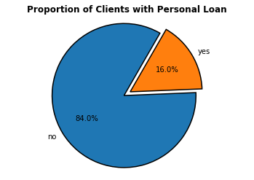
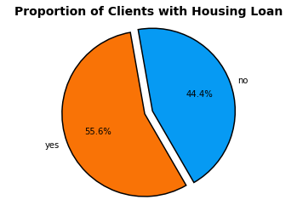
Housing/Personal Loans
7244 clients(16%) had personal loan
Rest 37972 clients had no personal loan
55.6% clients had Housing Loan (25130)
20086 had no Housing loan

Slide 9
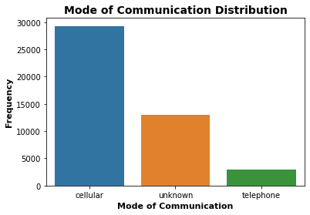
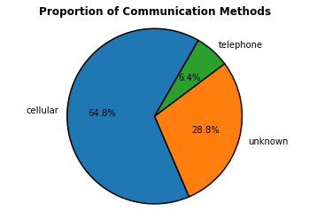
Communication Methods Used
64.8% clients(29290) were contacted through cellular
6.4% clients(2906) contacted through telephone
13020 clients through unknown means

Slide 10
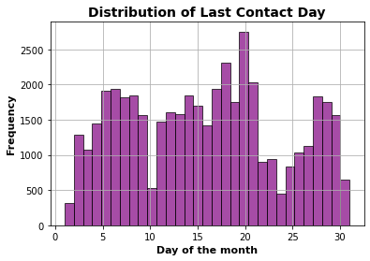
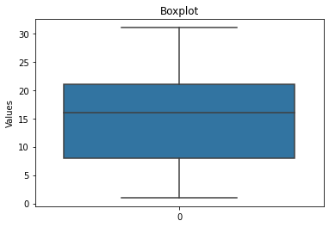
Last Contact Day
Minimum number of clients were contacted on 1
Maximum clients were contacted on 20 (2752)
50% clients were contacted by 16 of the month
75% clients by 21 of the month

Slide 11
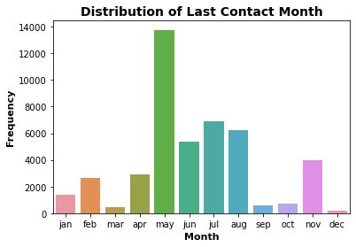
Last Contact Month
Maximum clients were contacted in May (13766)
Followed by 6895 clients in July
6247 clients in August
5341 clients in June
3975 clients in November
2932 clients in April
2649 clients in February
1403 clients in January
738 clients in October
579 clients in September
477 clients in March
Minimum no. of clients in December (214)

Slide 12
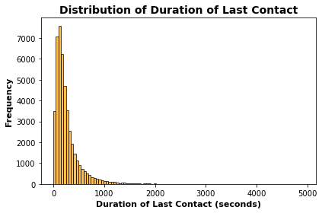
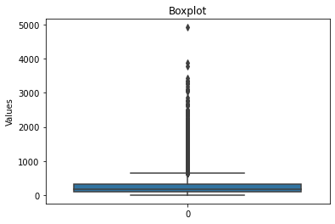
Last Contact Duration
The average duration of last contact was 258.166202 s
The median duration of was 180 s
The minimum contact duration was 0 s
The maximum contact duration was 4918 s

Slide 13
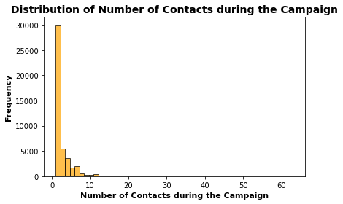
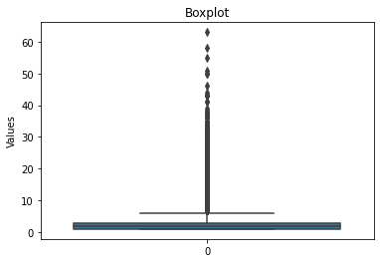
Number of Contacts performed this Campaign
The average number of contacts performed was 2.76
Minimum contacts made to a client being 1
Maximum contacts to a client was 63
The median contacts was 2
2 contacts were made to a Maximum of 17548 clients

Slide 14
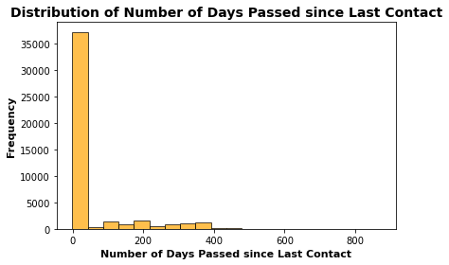
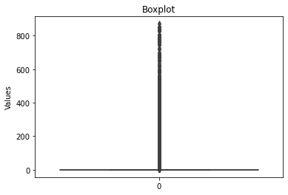
Days Since Last Contact
On an average 40 days passed since last contact for the clients.
36956 clients were not contacted previously.
For one client 871 days passed since last contact.

Slide 15
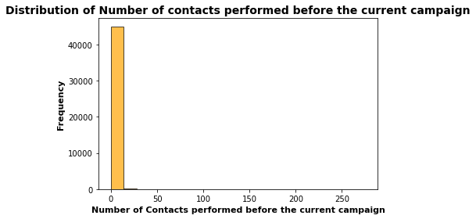
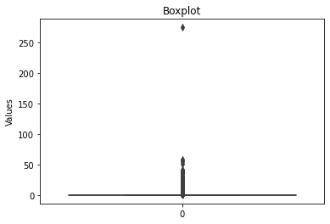
Contacts Before the Current Campaign
Before the current campaign on an average 0.5806 contacts were made to the clients.
Maximum of 275 contacts were made to one client.
While 36956 clients were not contacted before the current campaign.

Slide 16
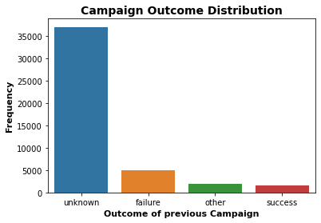
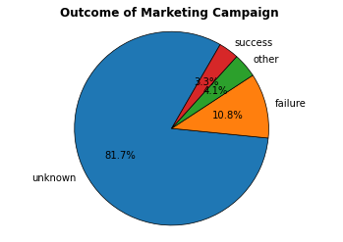
Outcome of Previous Campaigns
There was a 3.3 % success rate of the previous campaign with 1513 clients subscribing.
A 10.8 % failure rate with 4902 clients declining.
We don’t have data of about 38801 clients with unknown or other reasons of not subscribing.

Slide 17
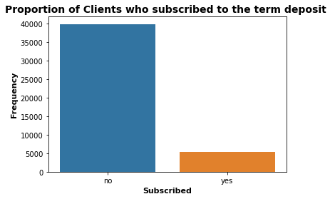
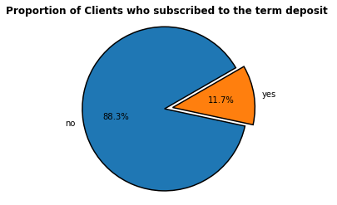
Subscribed / Not Subscribed
Around 11.7% clients (5294) subscribed to term deposit
88.3% clients (39922) did not subscribe to the term deposit

Slide 18
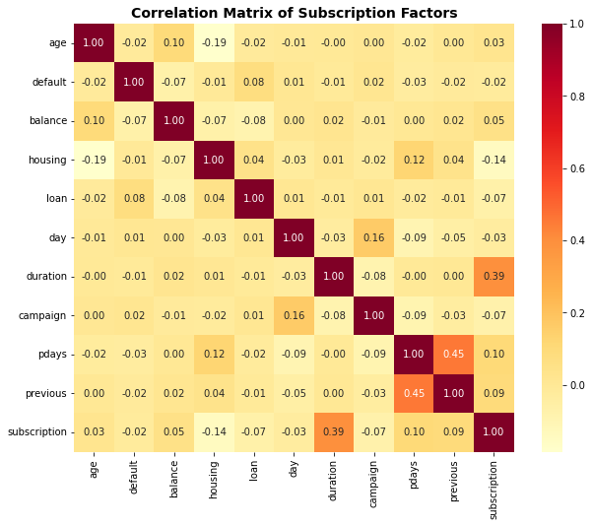

Slide 19
Correlation analysis
A positive correlation between duration of last contact and Subscription rate.
Slight positive correlation between subscription and pdays, previous.
Very minimal to slight positive relation between subscription and age, balance.
Minimal to very slight negative correlation between subscription and default, day.
Slight negative correlation between subscription and loan, campaign.
Negative correlation between subscription and housing.
( positive correlation(→1) means directly proportional, negative correlation (→-1) means inversely proportional , and (→0) no relation )

Slide 20
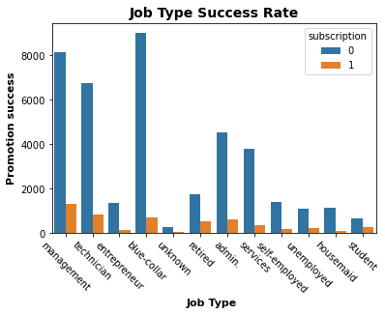
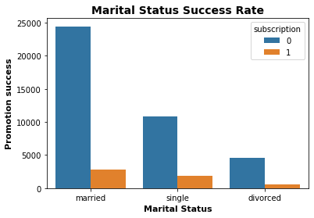
Categorical correlation

Slide 21
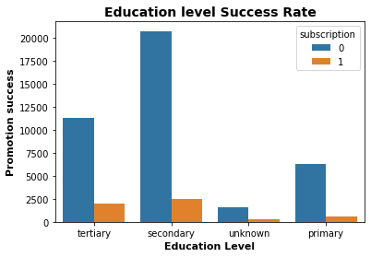
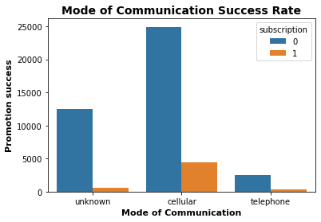
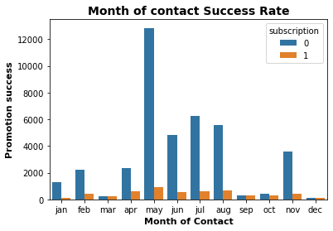
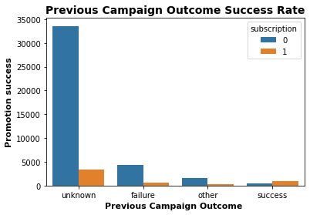

Slide 22
THANK YOU
BY SAGAR CHANDAN

